Slide 1



Slide 2
Agenda
Welcome and introductions
Introduction to Exercise Tangaroa
Overview of the how the exercise will be run in [insert region/agency]
[Health and safety in NCC/ECC/EOC]

Slide 3

Exercise Tangaroa 2016
Notes:
What is Exercise Tangaroa?
Exercise Tangaroa is a tier 4 national-level exercise, involving MCDEM, all 16 CDEM Groups, and many other national and lifeline agencies.
This is the second time we’ve run an Exercise Tangaroa (Tangaroa meaning God of the Sea). The first was in 2010, also involving all 16 CDEM Groups and was based on a distant source tsunami scenario. This was a one day exercise that was focused on notification and warning procedures and stopped just prior to the wave’s impact on land. The main difference between the 2016 version of Exercise Tangaroa and the 2010 exercise, is that this time the scenario is based on a regional source scenario, meaning there will be less time for notification and warning, and the exercise will also test the post-impact phase, including the transition to recovery and early recovery arrangements.
Tier 4 national exercises are generally held every two years, but a tier 4 exercise involving all of New Zealand has not occurred since 2010. (New Zealand Shakeout, a national earthquake drill was conducted in 2012 but is now considered more of a public education campaign than a national exercise.)

Slide 4
Aim
To test New Zealand’s arrangements for preparing for, responding to, and recovering from a national tsunami impact.
Notes:
The overall aim for Exercise Tangaroa is to test New Zealand's arrangements for preparing for, responding to, and recovering from a national tsunami impact.
This is quite a broad aim, so we’ve narrowed it down with more specific objectives.

Slide 5
Objectives
To lead a coordinated interagency response
To support a coordinated interagency response
To conduct high-level all of government decision making
To deliver effective public information management
To integrate lessons identified from previous events and exercises
To initiate the transition of response to recovery
To implement business continuity arrangements
To effectively manage information horizontally and vertically
To further develop collaborative relationships
Notes:
These are the nine broad objectives that have been developed for Exercise Tangaroa – they are strongly based on the generic exercise objectives that have been developed by the interagency national exercise programme.
The objectives cover areas such as leading and supporting a coordinated interagency response; initiating the transition from response to recovery; managing information and delivering effective public information; business continuity; and learning lessons and developing relationships.
Again, as these are also quite broad, they have been narrowed down into a number of measurable KPIs. These objectives and KPIs have been further broken down as part of our evaluation tool, which uses specific measures to identify whether or not these objectives and KPIs have been achieved.

Slide 6
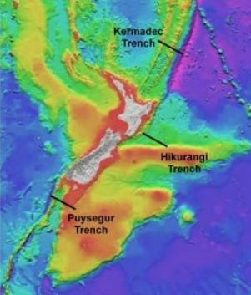
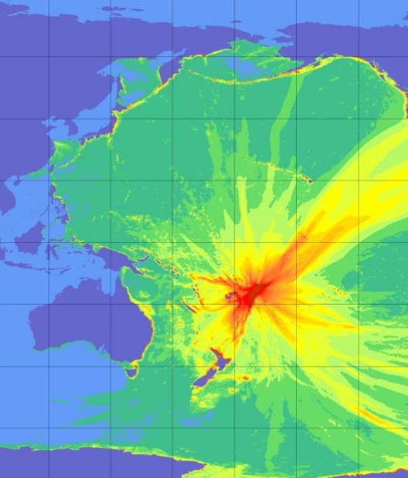
Scenario
Notes:
As mentioned earlier, a regional source scenario was agreed for Exercise Tangaroa; using a plausible and credible event that will provide some warning time for most of the country but not a lot, and will also impact as much of New Zealand as possible. The source earthquake will occur in the Kermadec Trench, with the exact size and location not being revealed until the day!

Slide 7
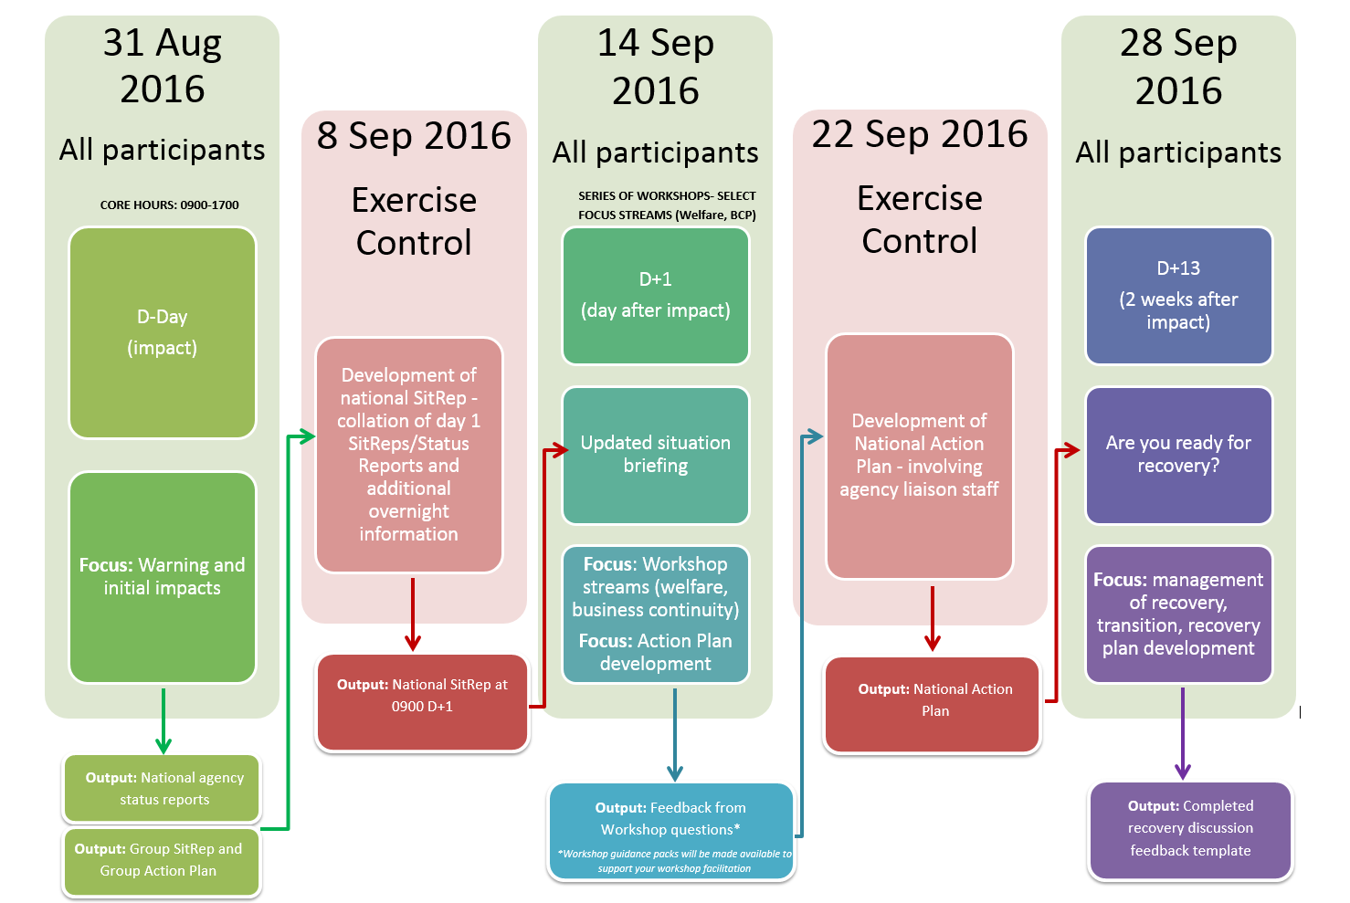
Dates
Notes:
Exercise Tangaroa is to be held over three days, each two weeks apart starting on 31 August 2016. There will also be 2 days of activity at the national exercise control level, one to prepare the National Situation Report to be included as an inject into day 2 of the exercise and one to prepare a National Action Plan.
There are currently over 100 organisations registered to participate in Exercise Tangaroa at a variety of levels (from full participation to facilitation only) – this includes regional and local councils, CDEM Groups, national agencies, and lifelines, including power and transport agencies.

Slide 8
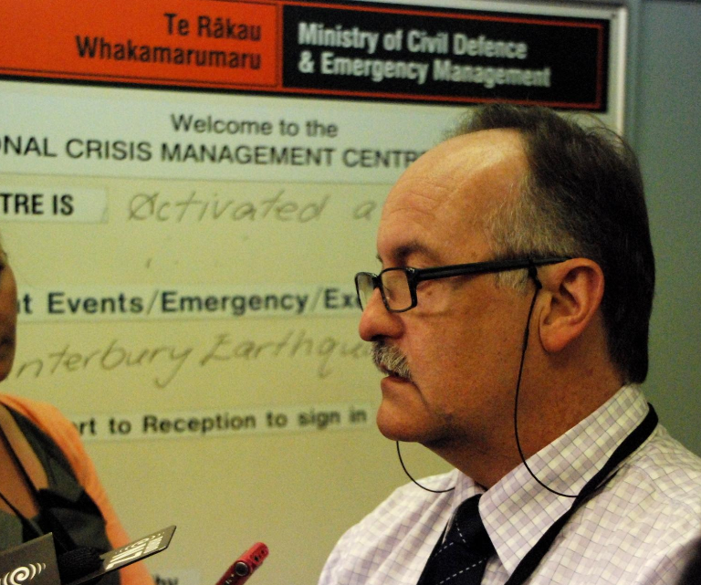
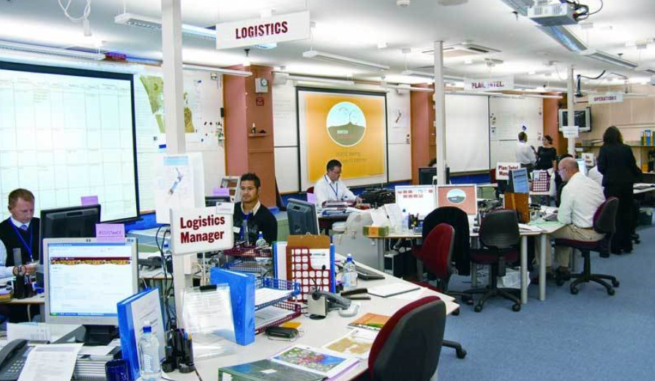
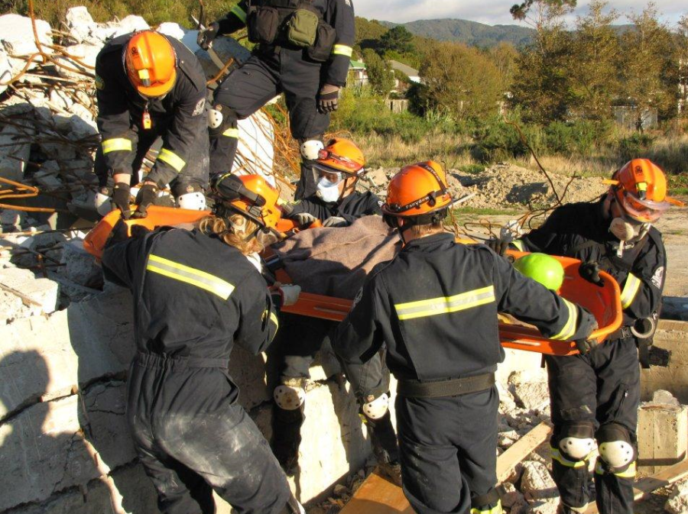
Wed 31 August 2016 – Warning and Impact
Notes:
Day 1 of the exercise will be the main day of exercise activity and will be based on a full scale exercise with activations of the NCMC, ECC and EOC’s around the country. The day’s activities will cover from initial notification of the earthquake and the generation of a tsunami, through to tsunami impact. We will be exercising generally through normal business hours on this day.
Testing may include (and is not limited to):
The National Warning System
EMIS
The declaration process
Business continuity arrangements
Public Information messaging
Community Response Plans
Mass evacuations
Welfare arrangements
Rapid Impact assessments
Mass casualty arrangements
The day will involve NCMC, CDEM Groups and partner agencies working together.

Slide 9
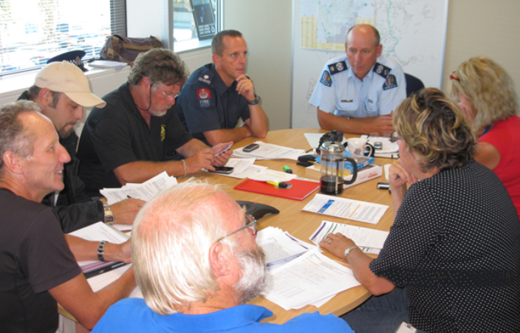
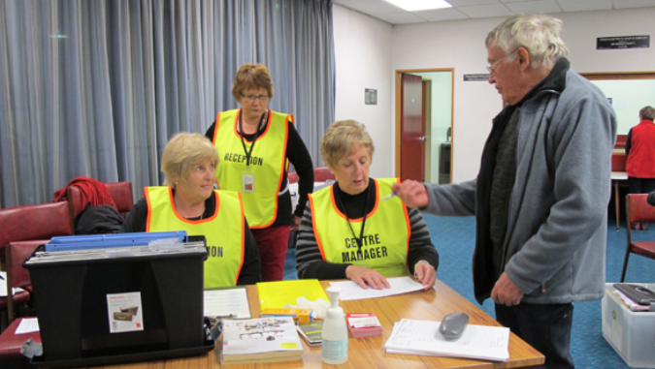
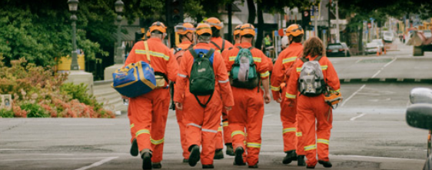
Wed 14 Sept 2016 – Post Impact
Notes:
Day 2 of the exercise falls 2 weeks later on 14 September, but will be the day after the tsunami impact in exercise activity (ie D+1), and will allow participating agencies to test post impact aspects which may not have been fully tested in day 1 of the exercise.
This particularly includes response elements with a welfare focus.
Day 2 will be based around table-top activity at National, CDEM Group local levels and and we encourage you to focus on workshops looking at welfare arrangements and business continuity plans.
CDEM Groups will be able to use the time between Day 1 and Day 2 to ready themselves for further full scale activities or table-top or workshops to discuss these aspects or to exercise actual community evacuations or activation of welfare arrangements or facilities.

Slide 10
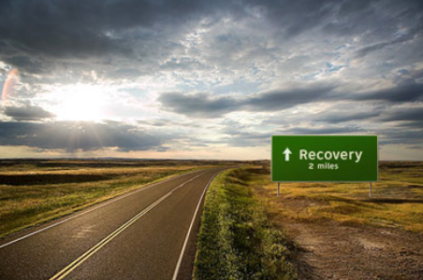
Wed 28 Sept 2016 – Transition to Recovery
Notes:
Day 3 of the exercise falls a further two weeks later, and is two weeks after the tsunami impact in exercise activity (ie D+13).
Day 3 of the exercise will be about testing the early elements of recovery, including the transition to recovery and recovery arrangements.
Again, the intervening 2 weeks will allow participants to work towards a workshop to discuss how they will transition from Response to Recovery in order to exercise some of the new recovery arrangements that will come into effect once new legislation has passed and to also help to develop further recovery arrangements.

Slide 11
Day 1 Exercise Sequence
Initiated with a simulated PTWC bulletin
After that, up to exercise players…..
Aim is for maximum realism (within resource limits)
Report times, shifts to be sorted on the day
Wait for the call……
Notes:
Day One activities will be Initiated with a simulated PTWC bulletin for those agencies that receive these. For those that don’t, they will receive the MCDEM National Warning System message once the MCDEM Duty Team have assessed the situation. No players should be ‘prepositioned’ for the exercise.

Slide 12
Exercise Control
[Who?]
[Where? (Location)]
Will handle all exercise admin queries
Will stand in for any non-participating agency
Notes:
Add notes regarding your agency’s exercise control arrangements.

Slide 13
Evaluation
[Who?]
[Debrief arrangements – hot and cold]
Notes:
Add notes about your Agency’s Evaluation arrangements.

Slide 14
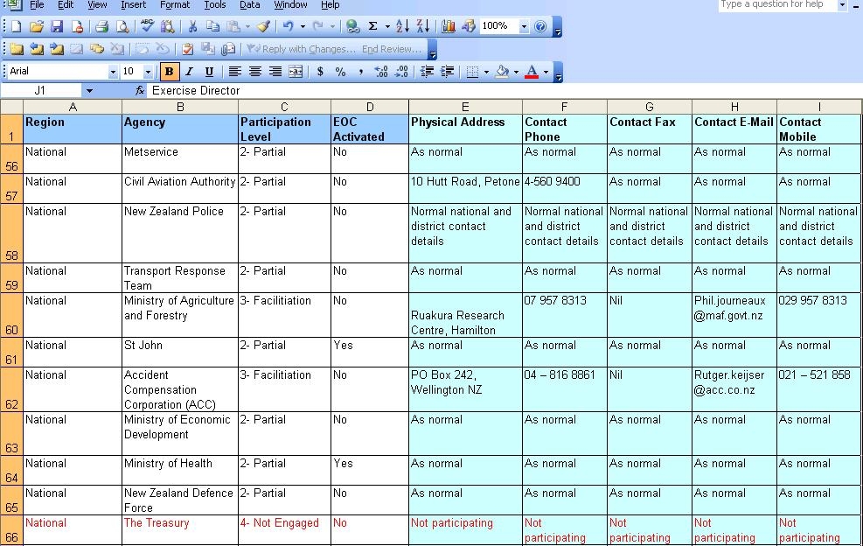
Participation and Venue List
Notes:
Not all of our usual agencies are participating on the day of the exercise, and if they are not all are using their normal emergency operations centres or contact details.
A participant and venue list detailing all of the exercise participants and their contact details is being prepared and will be made available prior to the exercise. This should be your main contact list for the day.

Slide 15
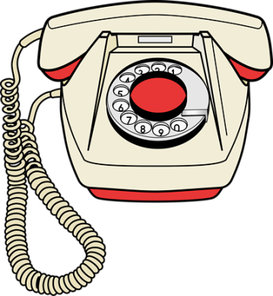

“This is an Exercise Tangaroa message”
“Exercise Tangaroa only”
Notes:
Please ensure that when you call someone, you tell them straight away that you’re calling in relation to Exercise Tangaroa.
And make sure you clearly identify any written communication with Exercise Tangaroa only.

Slide 16

“No Duff”
Notes:
Finally, if the exercise has to be cancelled due to a real event, you will be notified with a “no duff” message.

Slide 17
Remember…
This is a learning opportunity.
We are reviewing systems and processes – not you.
Be supportive of others – be a team.
If you are unsure, ask, don’t stress.
There will be opportunities for feedback during debriefs.

Slide 18
[Add any other slides as required for the briefing]

Slide 19

Notes:
Any questions?

